Slide 1

PMI NH Chapter
Business Acumen in a World of
AI and Automation
Donna Gregorio
VP, Professional Development
PMI Mass Bay Chapter
May 20, 2026
Notes:
Tx, pleasure, nuggets, best practices in how I use AI
Want to be engaging and help evolve your career.
Shoes are irreplaceable, not irrelevant.
AI rapidly changing orgs the way make decisions, manage portfolios, and deliver value.
For PMs, success is no longer about schedules — it’s about strategic thinking, business acumen, and using AI to drive smarter decisions.
Here to explore how AI can help PMs analyze portfolios, evaluate investments, identify risks, and improve decision-making through real-world use cases
Practical AI playbook that attendees can immediately apply in their organizations.

Slide 2

Setting the Stage: Background
AI is not the Advantage. How you use it is.
Everyone is talking about AI tools; few make better business decisions
Business Acumen = connecting to AI strategy, value, risk and outcomes
AI changes how organizations operate: automation, evolving roles, higher customer expectations
AI provides speed and insights; humans provide context, judgment, and trade-offs
AI will not replace project managers.
Project managers who combine AI with business acumen will replace those who do not.
Notes:
AI is not the advantage – you need to know how to use
Very few orgs making better business decisions with AI tools
PMs risk becoming tool users instead of strategic advisors
Business acumen in AI era means connecting AI to strategy, risk, investment decisions, and measurable outcomes.
AI = speed and analysis; humans = judgment, trade-offs.
Bottom line: AI won’t replace PMs, PMs who combine AI with business acumen will replace those who do not.

Slide 3
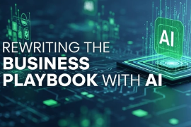
Presentation Agenda / Learning Objectives
How project leaders use AI to make smarter portfolio and investment decisions
Business Acumen Framework:
  Apply a business acumen framework to evaluate portfolios/projects using value, cost, risk, scope, and alignment to strategic impact
Use Cases
  Use AI to analyze portfolio scenarios and support better investment and prioritization decisions
AI Prompt Playbook for PM Leaders
  Build a practical AI playbook with reusable prompts for project and portfolio leadership decisions
Notes:
3 parts
1st: introduce business acumen – evaluate initiatives – value, cost, risk, scope, and strategic alignment.
Goal: shift thinking - delivering projs to making better investments
2nd: Use cases, demonstrate how AI can analyze portfolio scenarios, compare trade-offs, identify risks, and support smarter prioritization decisions.
3rd: Look at AI Prompt playbook for PM leaders – prompts, techniques, take back on Monday and apply to activities.

Slide 4
Business Acumen Framework: Five Filters
Value, Cost, Scope, Risk, Alignment
Notes:
Ensure that as a PM, you are irreplaceable, not irrelevant.
Can’t do it without you – look to you for guidance on what comes next. Stakeholders trust you with the success of the project, you are responsible for all decisions made.
Prioritization of projects / portfolios using AI – used to do it manually

Slide 5
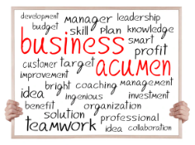
The Decision Framework
The Five Filter Model
Value: What business problem are we solving? Customer impact? Long-term organizational value?
Cost: Consider total cost of ownership – implement, maintain, license, support, train.
Scope: Is this foundational infrastructure, cybersecurity, regulatory, or enterprise-critical?
Risk: Does this reduce operational, financial, compliance, or reputational risk?
Alignment: Does this directly support strategic goals, or is this an interesting technology opportunity?
Notes:
To evaluate, consistent decision framework, beyond timelines / metrics.
Value – business problem? Customer impact? Long term org value?
Cost – implementation $, also support, maintenance, licensing, training.
Scope – Enabling the business or just a small department
Risk – project delivery risk, operations, compliance, reputational risk too
Alignment – Does proj support org strategy, or is it just “cool”?
Framework – helps prioritize investments – deliver business outcomes

Slide 6

The Old Way vs. The New Way
Project Manager Running EPMO – Managing 5 Portfolios
Need to prioritize portfolios
Manage the following 5 Portfolios
Move critical apps to the cloud
Upgrade wireless network
Implement internal Open AI version of ChatGPT
Upgrade Help Desk Services
Replace expense reporting system
Need to assign resources to portfolio teams
Kim, PM
Need to understand risks and mitigations
Need status reports
Notes:
Imagine you’re Kim, managing 5 portfolios, org can’t fund everything
Structured, business-focused approach to priorities
Five portfolios are: describe them
As PMs, help org make smarter investment decisions.
Evaluate through business acumen lens
Look at value? Risk? Strategy? Operational & financial impacts?
Example – move to the cloud – expensive but creates long-term stability
Upgrade wireless strengthens core infra, every employee needs
Internal AI may drive faster decisions, but also introduces governance
Upgrade help desk more operationally efficient
Expense reporting may improve user experience, lower strategic value
AI can rapidly analyze trade-offs, summarize risks, compare scenarios, and support prioritization discussions — but leadership still provides the judgment, strategic context, and final decisions.

Slide 7
Example: Portfolio Prioritization – AI Results
Portfolios | Value | Cost | Scope | Risk | Alignment | Priority | Comments
Move to the Cloud | Very high | High | Enterprise-wide | High | Very High | #1 | Long-term strategic value; foundational for digital transform
Upgrade wireless network | High | Med | Broad Infrastructure | Med | High | #2 | Core infrastructure dependency for every business function; immediate impact
Internal Open AI ChatGPT | High | Med | Cross-functional | Med / High | Very High | #3 | Will accelerate knowledge work, strong alignment to AI strategy
Help Desk Services | Medium | Med | Operational | Low | Med | #4 | Valuable but more tactical than transformational, lower strategic differentiation
Expense Reporting | Low / Med | Med | Departmental | Low | Low / Med | #5 | Operational improvement with limited strategic impact
Notes:
Result of AI analysis
Priorities based on business acumen framework (not politics/opinions)
AI summarizes rationale behind each decision
#1 – Cloud – long-term strategic value, foundational, scalability, future AI
#2 – wireless – Core dependency, impacts every bus function, immediate benefits across org
#3 – Chat – Aligns with AI strategy, accelerates knowledge work, decisions
#4 – Help desk – more tactical than transformational, less strategic
#5 – Expenses – limited strategic value
Example illustrates how AI helps organize data, trade-offs, support executive decision making, still rely human judgment for final decisions

Slide 8
Use Cases
Notes:
Partner with the technical team
Goal – not to replace PMs, reduce admin, PMs more strategic, stakeholders engaged, decision making.

Slide 9
The Old Way vs. The New Way
Project Manager Running EPMO – Managing 5 Portfolios
Need to prioritize portfolios
Manage the following 5 Portfolios
Move critical apps to the cloud
Upgrade wireless network
Implement internal Open AI version of ChatGPT
Upgrade Help Desk Services
Replace expense reporting system
Need to assign resources to portfolio teams
Kim, PM
Need to understand risks and mitigations
Need status reports
Notes:
Next is execution – assign resources, risks, status reporting
Time consuming, repetitive, inconsistent when done manually
AI helps analyze resource capacity, conflicts, staffing scenarios fast
Surface common proj risks, mitigation, patterns
Status – automate, executive-level summaries, key issues, trends

Slide 10
Use Cases: Old Way vs. New Way (1 of 2)
PM shifts from reporter to advisor
Use Case | Old Way | New Way (with AI)
Resource Management | Hard to allocate resources efficiently across multiple projects using manual spreadsheets, subjective assignments, reactive conflict resolution | Use AI to analyze list of resources / skills / availability / priority Outputs: Conflicts, alternatives, over-allocation, rebalances workload Leads to: higher resource utilization efficiency, reduced project delays and burnout, better portfolio predictability
Risk Management | Risks identified too late, too narrowly via brainstorming session, limited perspectives | Use AI to input project scope Outputs: expanded risk list, what could go wrong scenarios, mitigation ideas Leads to: broader thinking, faster risk identification, better preparedness
Notes:
THIS IS #3 IN AI PLAYBOOK – RESOURCE MGT
Resource Mgt: balance limited resources across competing priorities. AI can analyze workloads, skill gaps, resource constraints, project dependencies – recommend more effective staffing. Result – higher resource utilization, reduced burnout. Prompt gives teams repeatable way to do this analysis
THIS IS #4 IN AI PLAYBOOK – RISK MGT
Traditional risk mgt limited by time, experience, perspective. AI expands thinking – broader categories, patters, mitigations much faster. Leads to better preparedness.
In both cases, AI accelerates analysis and surfaces insights, while the project manager still applies judgment, context, and leadership to determine the best course of action.

Slide 11
Use Cases: Old Way vs. New Way (2 of 2)
PM shifts from reporter to advisor
Use Case | Old Way | New Way (with AI)
Portfolio prioritization | Too many projects, unclear priorities, subjective decisions, politics-driven | Use AI to analyze list of portfolios given rubric and ROI Outputs: Quantitative recommendations, guidance Leads to: better tradeoff conversations to support structured decision making
Status Reports: PMs spend hours making status reports that don’t help make decisions | Manual updates, static PowerPoints, backward looking | Use AI to input team notes, schedule, work to date Outputs: Executive summary, key risks, recommended actions Leads to: faster reporting, insight-driven decisions
Notes:
THIS IS #1 IN THE AI PLAYBOOK – PRIORITIZATION
Already covered this. Slide shows old way vs. new way, playbook shows the actual prompt.
Teams can reuse the prompt, faster prioritization, better decisions, data-informed
THIS IS #2 IN THE AI PLAYBOOK – STATUS REPORTING
Saw this one earlier too. AI reduce manual labor, key milestones, insight-driven decisions rather than reporting on activity. What is value, decisions needed, next steps.
AI shift PMOs from admin to more strategic portfolio leadership.

Slide 12
AI Playbook
10 Example Prompts
Notes:
Key job of the Project Manager is to drive mission success.
AI playbook, more important part of job is setup, rest of project will run smoothly

Slide 13
The Playbook: 10 Practical AI Use Cases (1 of 2)
Process walkthrough
AI Use Case | Business Value
Portfolio / Project Prioritization | Improves strategic decision-making and prioritization
Executive Status Reporting | Produces concise executive summaries and leadership insights
Resource & Capacity Planning | Identifies workload conflicts and staffing alternatives
Risk Management | Expands risk visibility and mitigation planning
Communications Planning | Improves stakeholder engagement and transparency
Project Charter Development | Accelerates project initiation and stakeholder agreement
Notes:
Portfolio Prioritization: applies business acumen framework, produces ranked view with explanation.
Status Reporting: What needs leadership attention / decisions, value, next steps, repeatable.
Resource Management & Capacity Planning: Hard to do capacity planning across an org, helpful to have AI to do the data analysis, try it again.
Risk Management: Be sure to capture risks, mitigations and put into project plan, missed opportunity, generate heat map, less reactive, proactive risk anticipation.
Communications Planning: Info flow, key audiences, need to know, often update. Structured, reducing noise while improving engagement.
Project Charter: Generates project charter aligns stakeholders at initiation and through project. Executive summary, project purpose and value, outcomes, decisions needed, scope.

Slide 14
The Playbook: 10 Practical AI Use Cases (2 of 2)
Process walkthrough
AI Use Case | Business Value
Consolidated Scheduling | Creates integrated roadmaps, milestones, and checkpoints
Weekly Prioritization | Helps leaders focus on highest-value work
User Stories & Work Breakdown | Improves execution clarity and accountability
Dependency Mapping | Identifies cross-project conflicts and bottlenecks
Leadership Mindset Shift
Traditional PM: Reactive * Manual * Execution-focused
AI-Enabled PM: Proactive * Insight-driven * Value-focused
Notes:
Consolidated Schedule: Builds integrated, prioritized project schedule that aligns all workstreams into a single view.
Weekly Prioritization
User Stories & Task Breakdown: Converts high-level requirements into a detailed execution plan of 20+ actionable tasks. Improves execution clarity by linking requirements directly to named owners and structured task delivery.
Dependency Mapping Across Projects: Analyzes the portfolio to identify where projects intersect and depend on one another across key dimensions like infrastructure, vendors, resources, and timelines. Provides dependency map that helps leaders proactively manage sequencing, reduce conflicts, and improve cross-project alignment.
Additional use cases: These additional use cases extend the playbook beyond portfolio oversight into day-to-day execution and decision support. They help individuals and teams prioritize weekly work, structure meetings, and extract clear actions from discussions, while also generating executive briefing packs and stakeholder-specific communications. Together, they strengthen operational discipline by improving how work is planned, discussed, and followed through, and they provide faster, more consistent support for issue triage, decision-making, and project recovery when things go off track.
Others include weekly task prioritization, meeting agenda and decision structuring, meeting notes with action extraction, executive briefing pack generator, issue triage and escalation prioritization, stakeholder specific messaging generator, project recovery / red flag analysis, decision support “what should we do?” prompt

Slide 15
Key Takeaways
Notes:
Be the leader who knows the most about everything on your project,
What is your personal gap analysis of what we have discussed, have you tried any of these prompts during this session? Try them on your project on phone or on laptop

Slide 16
Personal Leadership Reflection & AI Action Plan
Reflect on Your Leadership Style
Consider Your Profile Gap
Where do I naturally default: execution or strategy?
Which decision lens do I underuse: value, cost, scope, risk, or alignment?
What leadership conversation do I need to start when I return to work?
Monday Morning Takeaway
Immediate actions: Identify one process that could benefit from AI-assisted decision support and apply AI to try it out; share one AI use case with your team
Connect back to PMI’s Mission: Lifelong learning, professional growth, continuous adaptation in an AI-enabled world
Notes:
Reflect on our own decision-making gaps
Do you tend to approach work with execution or strategy
Which lens do you underuse – value, cost, risk, scope, alignment?
Intentional awareness – rebalance how you think and decide
Monday morning takeaway is simple: organizations and chapters that learn to design, prioritize, and operate with AI as a core capability will be the ones that define the future of work and lead the next generation of delivery excellence.
Use ai every day

Slide 17

Final Message
The Future of Professional Development
Organizations and chapters that learn to design with AI – not just experiment with it – will shape the future of professional development leadership, and member value.
AI will not replace project managers.
Project managers who combine AI with business acumen will replace those who do not.
Notes:
Shift from traditional to AI-enabled PM
Traditional PM – reactive, manual, execution-focused
AI-enabled PM – proactive, insight-driven, centered on value creation
State of the PM role: evolving from task manager to strategic advisor, from status reporting to decision support.
Critical skills: financial thinking, strategic questioning, data interpretation, exec comms
PMI—lifelong learning and continuous adaptation will define the next generation of leaders who thrive in an AI-enabled world.

Slide 18

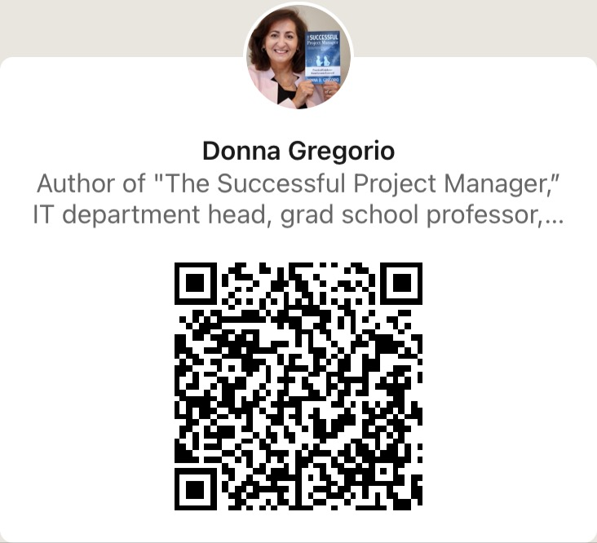
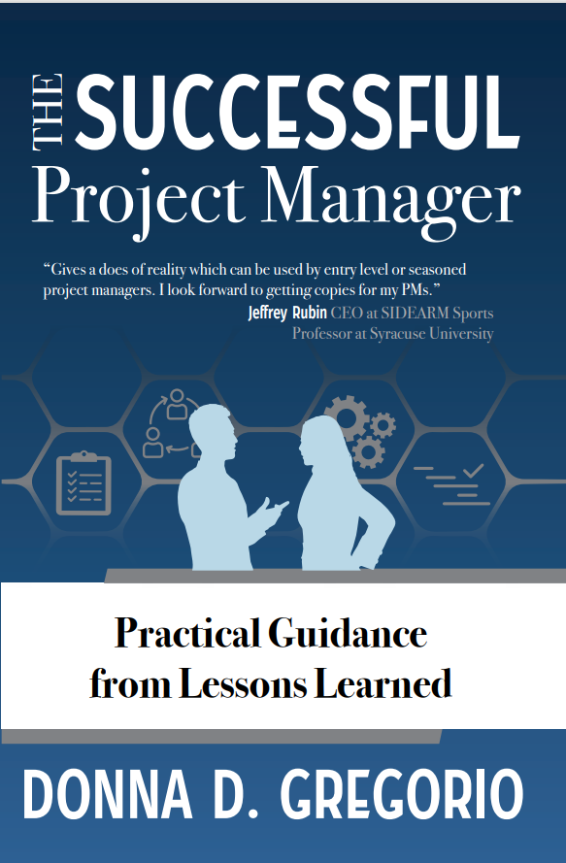
Questions? d.gregorio@pmimassbay.org https://www.DonnaGregorio.com
Notes:
Questions, Connect

